Slide 1
Manuscript Learnability and Indigenous Knowledge for Development – Hausa Ajami in Historical Context
Abdalla Uba Adamu
Department of Mass Communication
Bayero University, Kano, Nigeria
Rutgers, Islam and African Literature, 26th October 2015

Slide 3
Core Arguments
Scriptural transferability as a basis for sustainable indigenous knowledge development
Historicity of Islamic educational structure and the avenues for scriptural ownership
Transferability carries with it embedded preservation of the core ideas of the text

Slide 4
Literacy…
The central core of learning is literacy—the ability to comprehend and produce natural language in its written form
or
the ability to use both written and spoken language to accomplish specific problem-solving and communicative tasks arising in the workplace…
…or in conducting transactions within everyday institutions of the community

Slide 5
Scriptural Transferability
This is the ability of an individual to transfer acquired scriptural skills from one learning context to another
Thus an individual with two or more scripts can be empowered to use both the scripts to produce a superior individual with only one scriptural ownership
Such ability creates meaningful transfer of concepts and ideas between the two contexts
It connotes transfer of shared meanings

Slide 6
More of the same…..
Scriptural Transferability widens up access to education and fulfils the empowerment functions of mass education especially in societies with multiple forms of literacy
The theory of scriptural transferability is explored through historical matrix
We need to engage with history to understand what leads to the need for reconstruction of scriptural transferability as a civil society strategy among Muslim Hausa learners

Slide 7
What does all this mean…?
Competence with written language, both in reading and writing, is known as literacy
When a large number of individuals in a society is competent in using written language to serve these functions, the whole society may be referred to as a literate society
two dimensions of the script are important in understanding the growth of literacy: learnability and expressive power
Learnability refers to the ease with which the script can be acquired
Expressive power refers to the resources of the script for unambiguously expressing the full range of meanings available in the oral language

Slide 8
The ease of acquisition of a script is an important factor in determining whether a script remains the possession of an elite or whether it can be democratized, that is, democratization of a script appears to have more to do with the availability of reading materials and of instruction in reading and the perceived relevance of literacy skills to the readers
Even in a literate society, most readers learn to read only a narrow range of written materials…
…specialized materials, such as those pertaining to science or government, remain the domain of the elite who have acquired additional education

Slide 9
So….?
Literacy leads to logical and analytic modes of thought, general and abstract uses of language, and critical and rational thought
In politics, literacy is said to be necessary for governments to function adequately and provide individuals with social equity
Literacy produces people who are innovative, achievement-orientated, productive, politically aware, more globally aware, and less likely to commit crime, and therefore more likely to take education seriously

Slide 10
Mission Statement…
I intend to show how the Muslim Hausa of Northern Nigeria have made the transition from orality to scripturality and eventually literacy…
…by associating onomatopoeic graphic coding within their cultural environment to represent phonological sounds and thus enable them to effectively manipulate an acquired literary script to express Hausa language
This resulted in an indigenously adapted script, the Ajami, derived from Arabic script.
This transition, however, is not peculiar to Hausa Muslims. It was developed where ever Islam had a stronghold

Slide 11
From Scripturality to Literacy
In the 7th century, Arabic, immortalized in the language of the Holy Qur’an, and Islam became inseparable.
As Islam spread, the tongue of the Arabs rapidly spread as a part of the new religion.
In a few decades, it became a leading world language and the intellectual medium which united most of the civilized world.
Soon enough the Arabic script began to be adopted by the languages of the people who had been converted to Islam in much the same way the English Roman script in Imperially controlled lands, and Cyrillic in Soviet sphere became used as bases for literacy

Slide 14
The spread of Arabic script was quite rapid
Within a few centuries, Kurdish, Persian, Pashto, Turkish, a number of tongues in the Indian sub-continent and languages like Berber in North Africa and Spain began to utilize the Arabic script
Its embracement by a great number of non-Arab Muslim tongues formed a cultural boundary which demarcated the Islamic world from other lands
Later, a good number of the Malayo-Polynesian dialects, the vernaculars of the Muslim peoples in West and East Africa, some of the languages of Central Asia, the Indian sub-continent, and a few Slavonic tongues in Europe, adopted the Arabic script

Slide 15
Islam and Education Western Sudan
The direct antecedent of both Islam and Islamic education in Hausaland were Dyula scholars and merchants.
Dyula, Malian Malinke word for “trader”, represents a practice of a people, originally from Mali, but spread to many towns, rather than a tribe
These towns included Kong, Buna and Bonduku in the Ivory Cost (Cote d’Ivoire), Bobo-Dioulasso and Safane in Upper Volta (Burkina Faso), and Wa and Bandai Ghana

Slide 16
It is this itinerant Dyula tradition that brought Islam to Hausaland as early as 1320 to Katsina, and under specific group of Wangara merchants, to Kano in about 1380
In this regard, it seemed to have been agreed by historians that Islam came more directly to Kano, via Dyula merchants as early as 1380 during Sarki Ali Yaji
By 1480, during the reign of Sarki Muhammad Rumfa, a scholastic tradition had been established with a well structured faculty and curricular structure that provided an effective template for the education of a citizen in a society

Slide 17
It was during this period that the Arabic alphabet was adapted to express Hausa thoughts in a form which became universal throughout the Muslim world as ajami
Thus what subsequently evolved was an intricate system of basic education with a well-orchestrated early learning strategies.
Retained were the fundamental divisions of maktab, which in Hausaland became “makarantar allo” because the writing surface was allo, a wooden slate; and the madrassa, “makarantar ilimi” or knowledge school which reflects higher order learning with more extensive curriculum

Slide 19
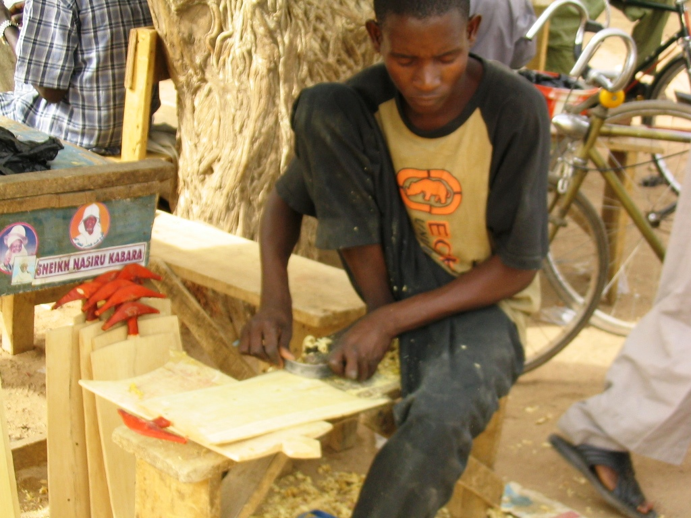
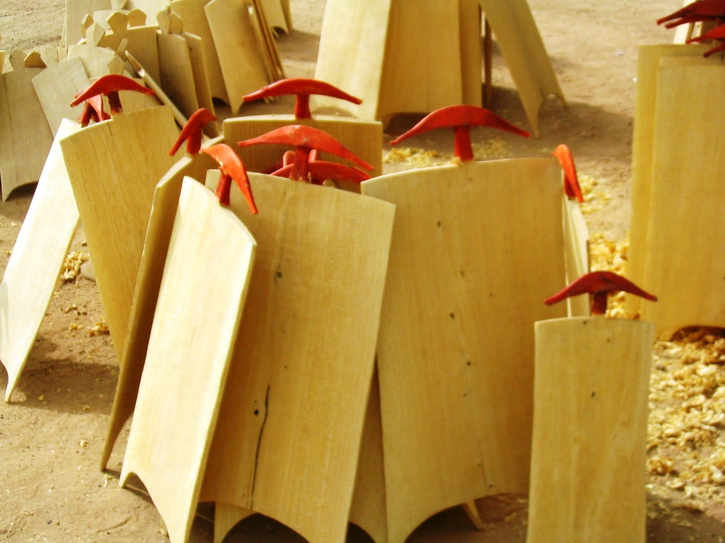

Slide 20
Stages of Rumfa’s Policy on Education
Babbaku
“letter” (baƙaƙe) recognition with a mnemonic device that makes it easy for young learners to absorb
Shift from orality to scripturality
Onomatopoeic sound association between an alphabet and its visuality
the letters of the alphabet with a corresponding behavior
Let’s illustrate with the Arabic letter “G”

Slide 21
Ghainun
غ

Slide 22
غ
Similarities and Variations
ع
Gan bakin wofi
“g” empty mouth
An bakin wofi
“g” empty mouth

Slide 23
The curriculum is of course the Holy Qur’an text
letter recognition is started with writing out the Surat Al-Fatiha to Surat Al-Fil - a total of 11 suras
These eleven suras contained the entire Arabic alphabet, except Z, which is in the next Surat, Al-Humaza

Slide 24
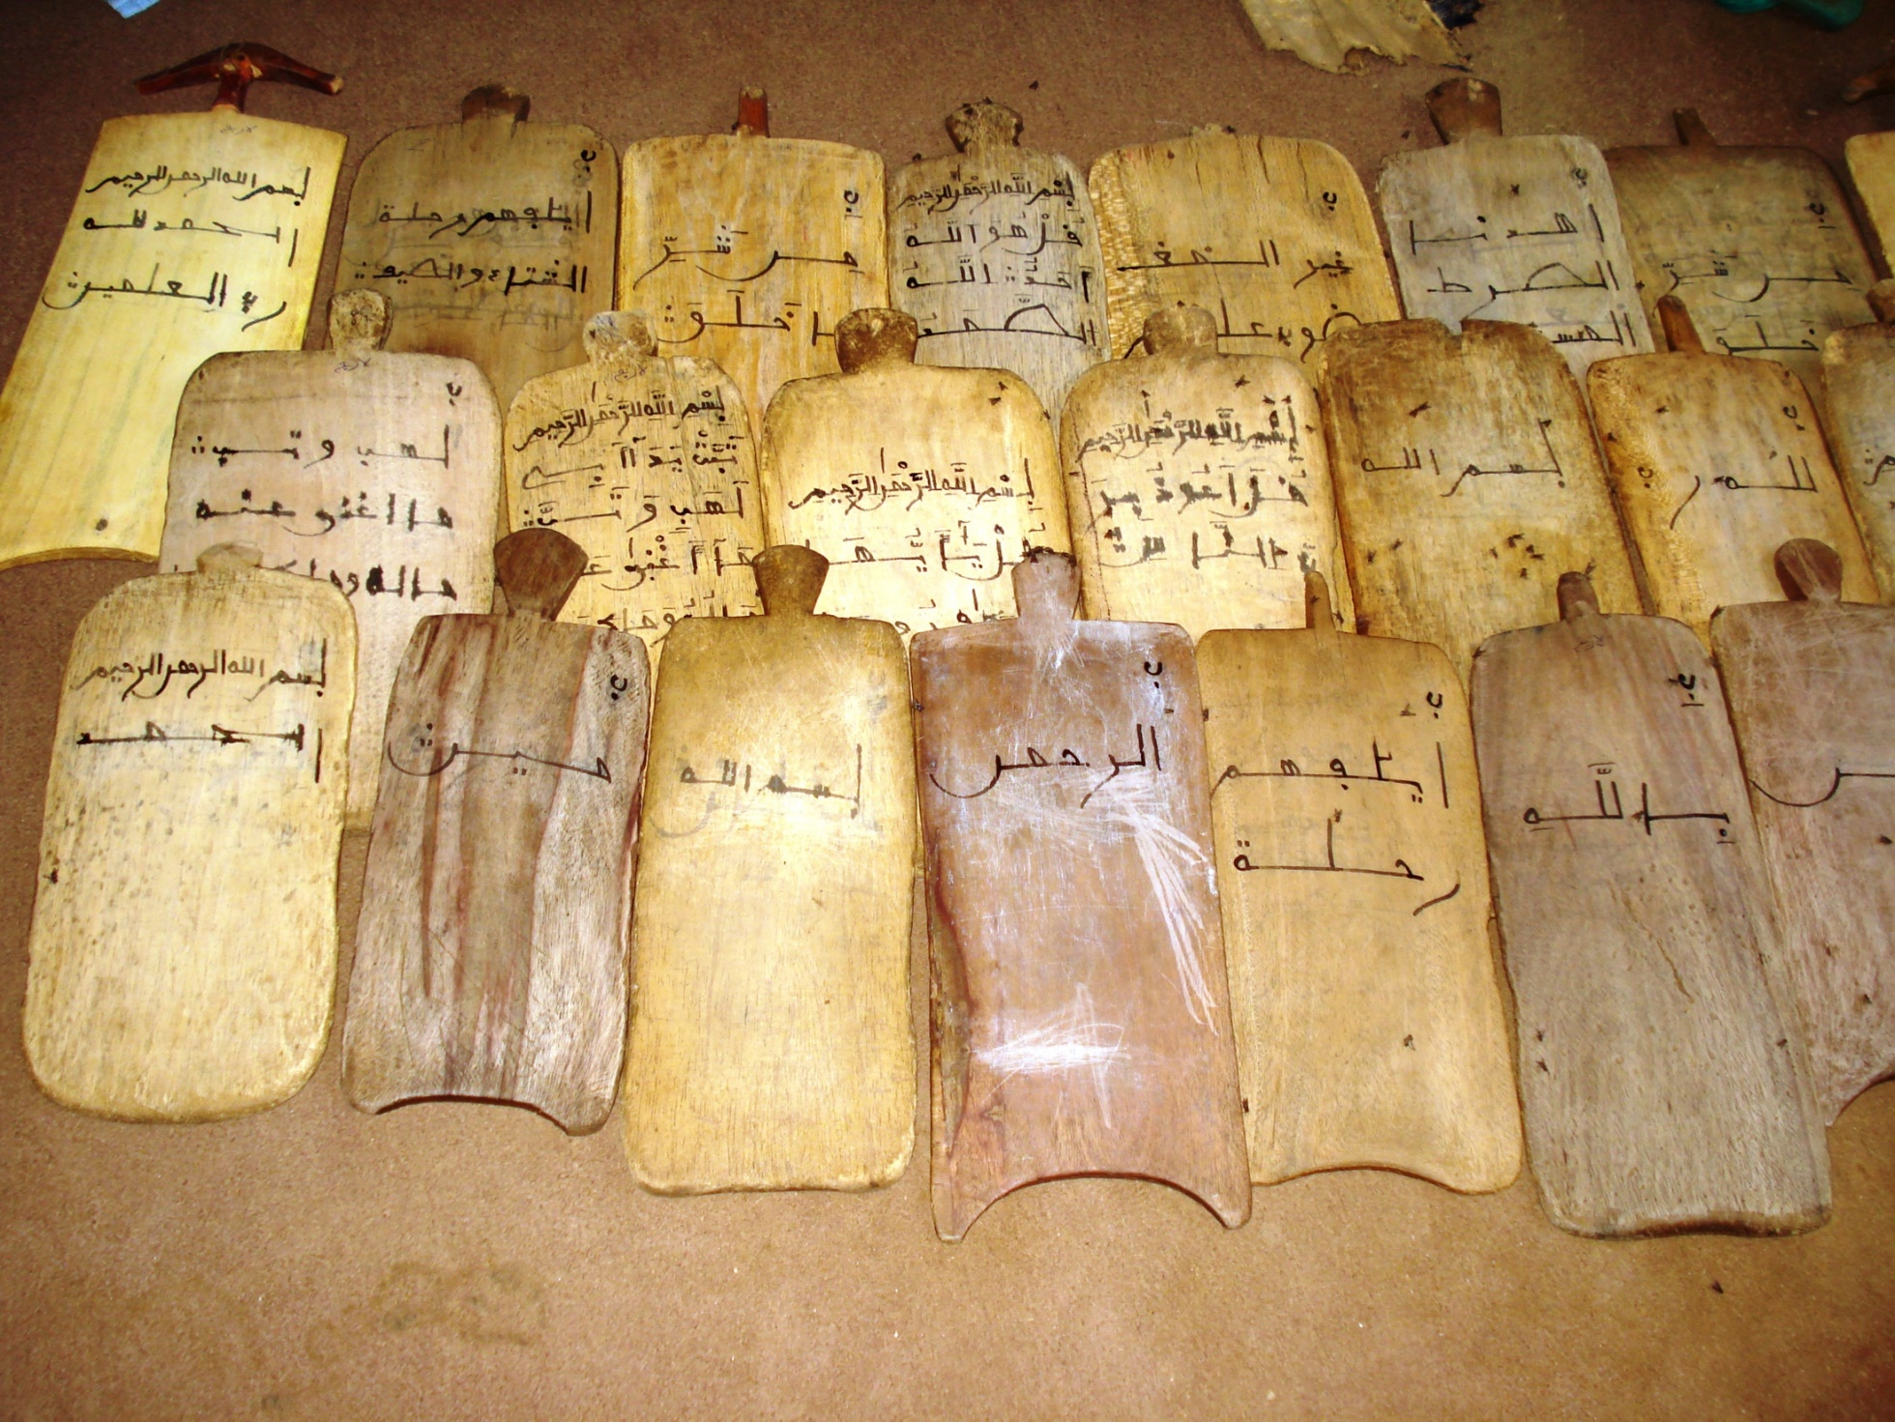

Slide 25
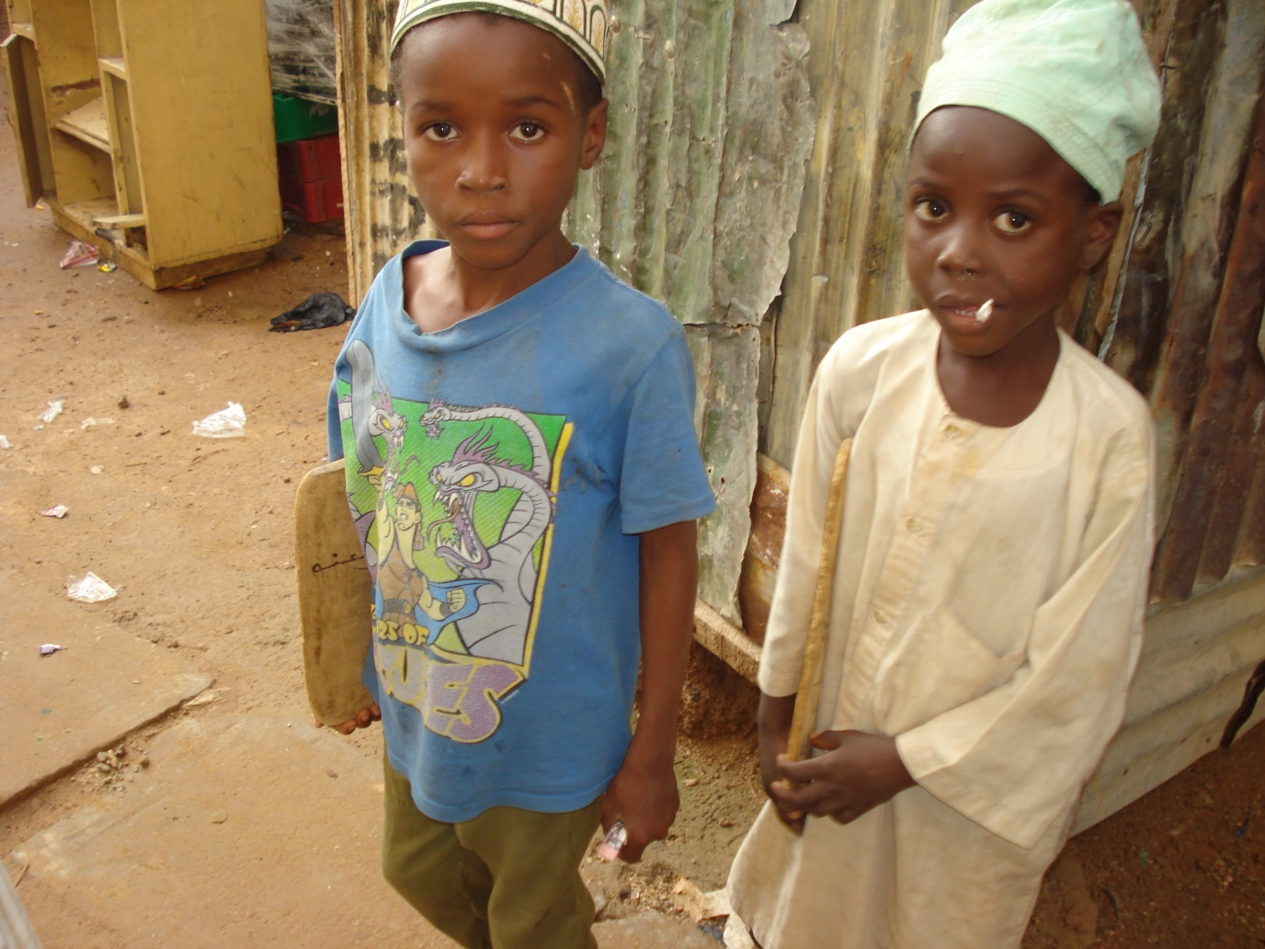

Slide 26
Farfaru
The beginning of vowel and word formation
Vowels are attached to the letters to form a word
The curriculum for this stage remains the same as the Surats covered in the first stage,
Only now they have proper vowels and complete words are formed.
The teacher reads out the word to the learners
which the latter repeats after the teacher until the teacher becomes satisfied with the pronunciation

Slide 29
From Surat al-Humaza onwards
it is expected that the learner can now understand the Arabic reading of the Surat and the ones that follow
and the subsequent curriculum is in pure Arabic
with less emphasis on the Ajamized and iconic letter recognition of the earlier stages

Slide 30
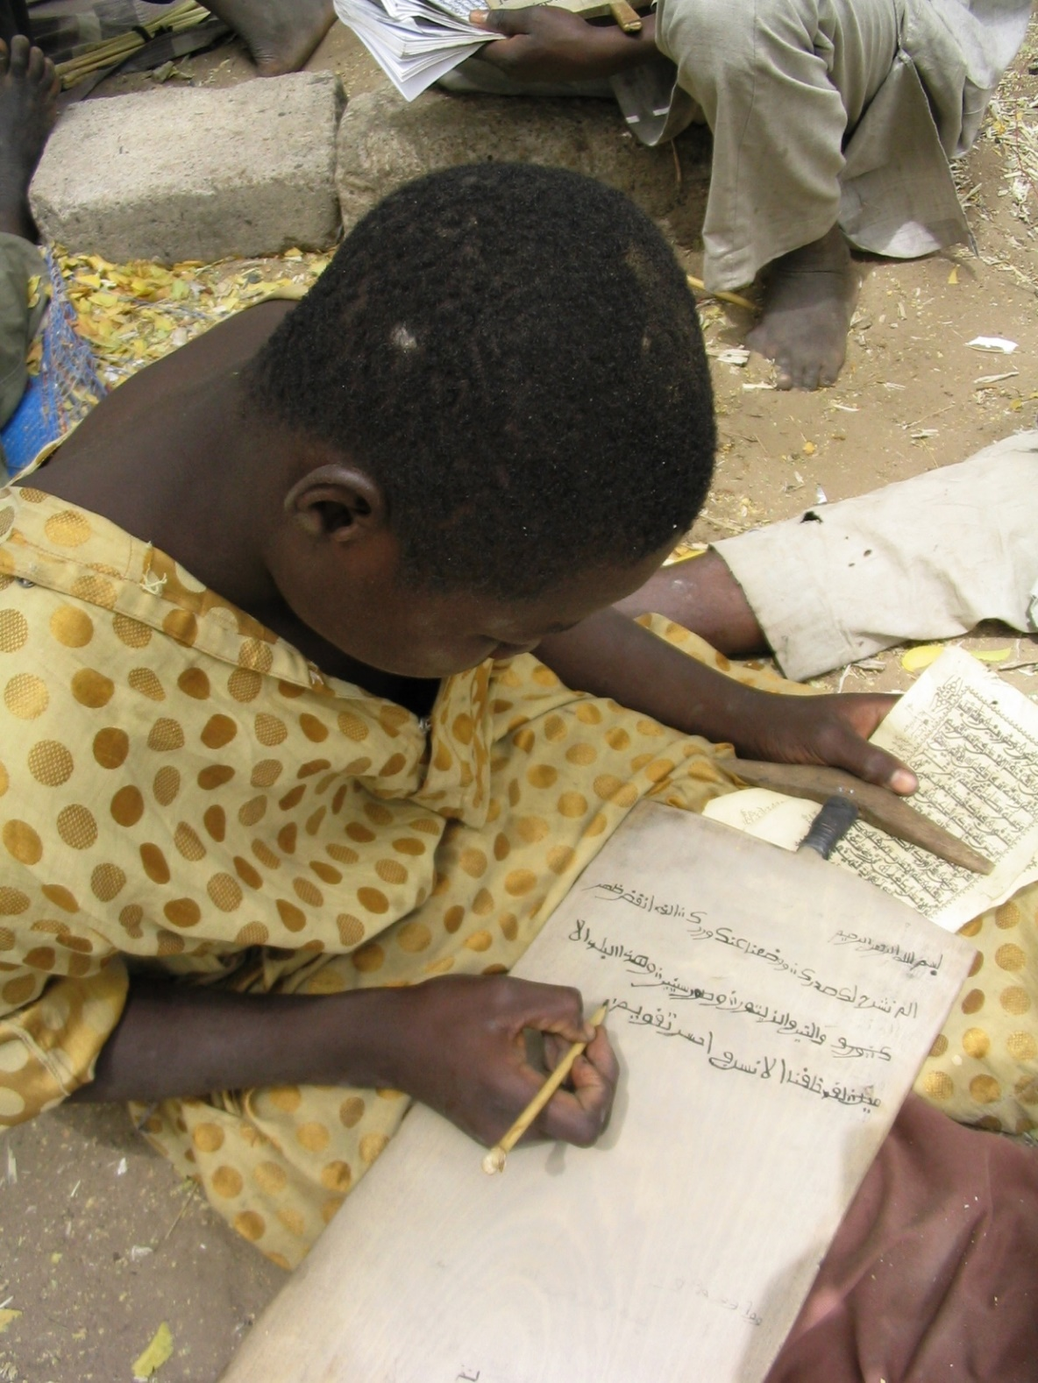
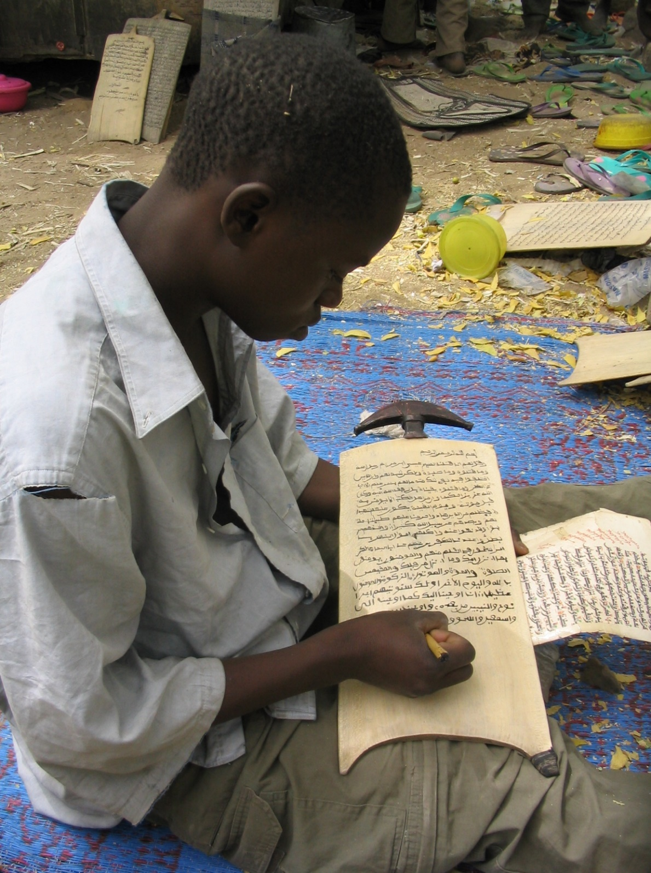

Slide 32
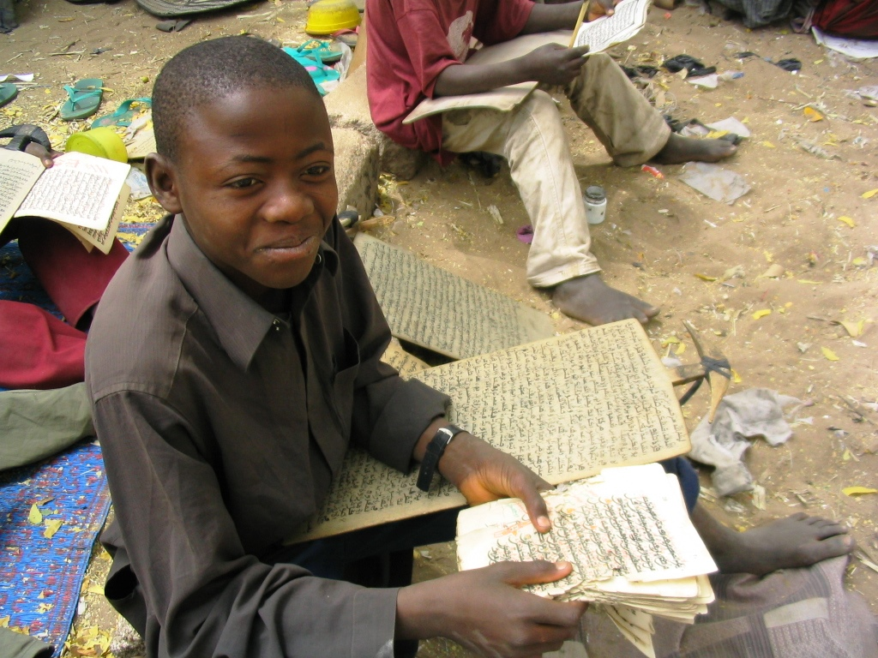

Slide 33
Zube
This entailed learning, reading and writing the Holy Qur’an
The pupil, now a master copier, copies all the 114 Surats of the Qur’an on his allo segment by segment
until he finishes the whole book and masters the art of writing and recitation devoid of mistakes in pronunciation, rhythm, style or penmanship

Slide 35
At this stage, which ends his elementary education, he graduates in a process called sauka,
usually marked by public reading of the Qur’an by the pupil
from a brilliantly decorated allo, zayyna
which becomes his certificate, and a proof of academic proficiency
For many pupils, this marks the end of the basic Qur’anic education
the process, lasting years, would have certainly make them literate enough to use the Arabic script in any context

Slide 36
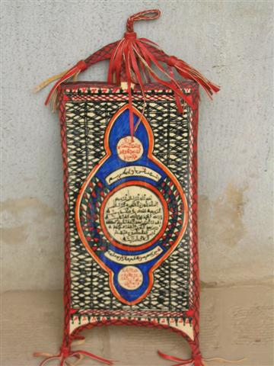
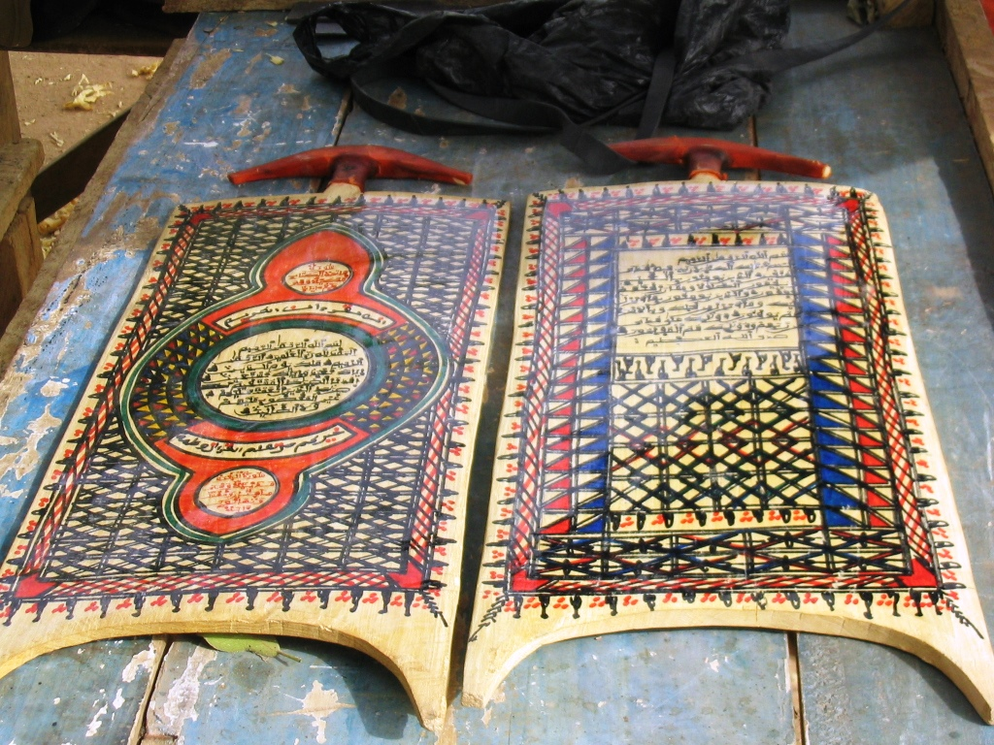

Slide 37
Haddatu
A boarding pupil or one within easy reach of the school may continue with his studies after graduation at a higher level with the aim of becoming a Mallam
He continues with more advanced syllabus from a stage called haddatu
which sees the beginning of the learning of the Qur’an off-head
The allo is of course replaced with the printed Qur’an
Once he can commit the entire Qur’an to memory, he moves to the next class, Tilawa

Slide 38
…a revision stage and enables him to perfect his mastery of reading of the Qur’an from his memory
…rather than from the printed book
Once he can commit the entire Qur’an to memory, he is expected to reproduce it in the next stage of learning, satu
which means entails writing the portion of the Qur’an from memory until he can write out the complete Qur’an which becomes his dissertation

Slide 39
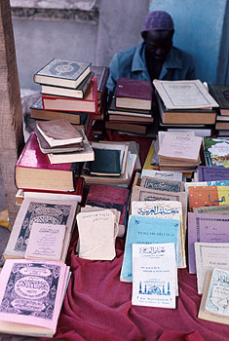
Madarasa learning and Support
Zinder,Niger
Islamic bookseller, Bondoukou , Cote d’Ivoire

Slide 40
He is then subjected to musabaha
a process in which he publicly submits and reads this dissertation
Once he completes this dissertation to the satisfaction of his examiners…
…he becomes a Hafiz
after which he can either terminate his studies,
or go for specialized advanced studies
In any event, he has become a Mallam, and can proceed, if he so wishes, to the next stage of his education, the madrasa

Slide 42
Crossing the Rubicon of Literacy
This system of education—introduced in or earlier than 15th century and modified along the centuries, and a template for Indigenous Knowledge base of the Muslim Hausa —persists to date.
It provides the primary contact of the Hausa learner with a formalized literary curriculum.
At the beginning of the introduction of this system, this created a desire to innovate and experiment, with the result that a scholastic community became formed, and a means of communication between people became facilitated by the simple fact that they have mastered the alphabet and can now communicate their thoughts in Arabized Hausa, or Ajami

Slide 43
The boat needed to cross the river of Rubicon that divides the Muslim Hausa from sustainable indigenous development is made up of the woods of scriptural transferability
A base for scriptural ownership does demonstratingly exist at all levels.
It is a template for sustainable local literacy.
This is more so since this system of education…..

Slide 44
This system of education serves the individual and community.
It is not geared towards State fulfilment of employment requirements
It therefore produces a more dedicated student
The goal of learning is ultimate self-realization, not a lucrative job
Its scriptural bases can be used by local communities to share their knowledge of sustainable development in agriculture, education, health, commerce, industry, and community development

Slide 45
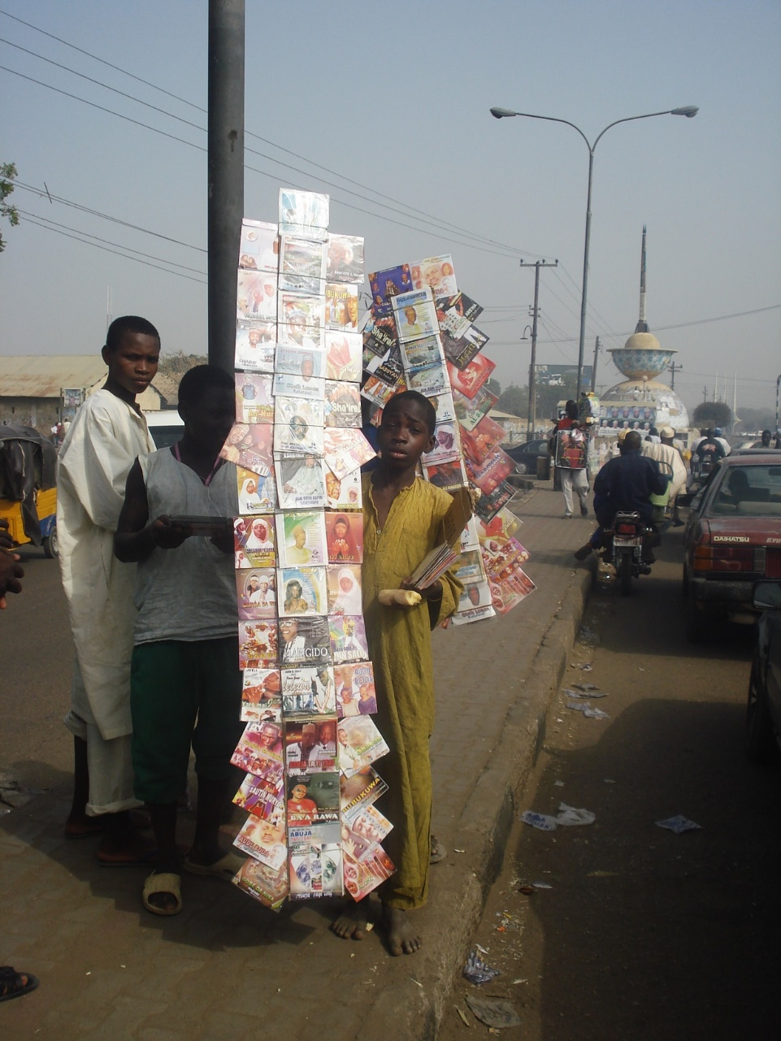
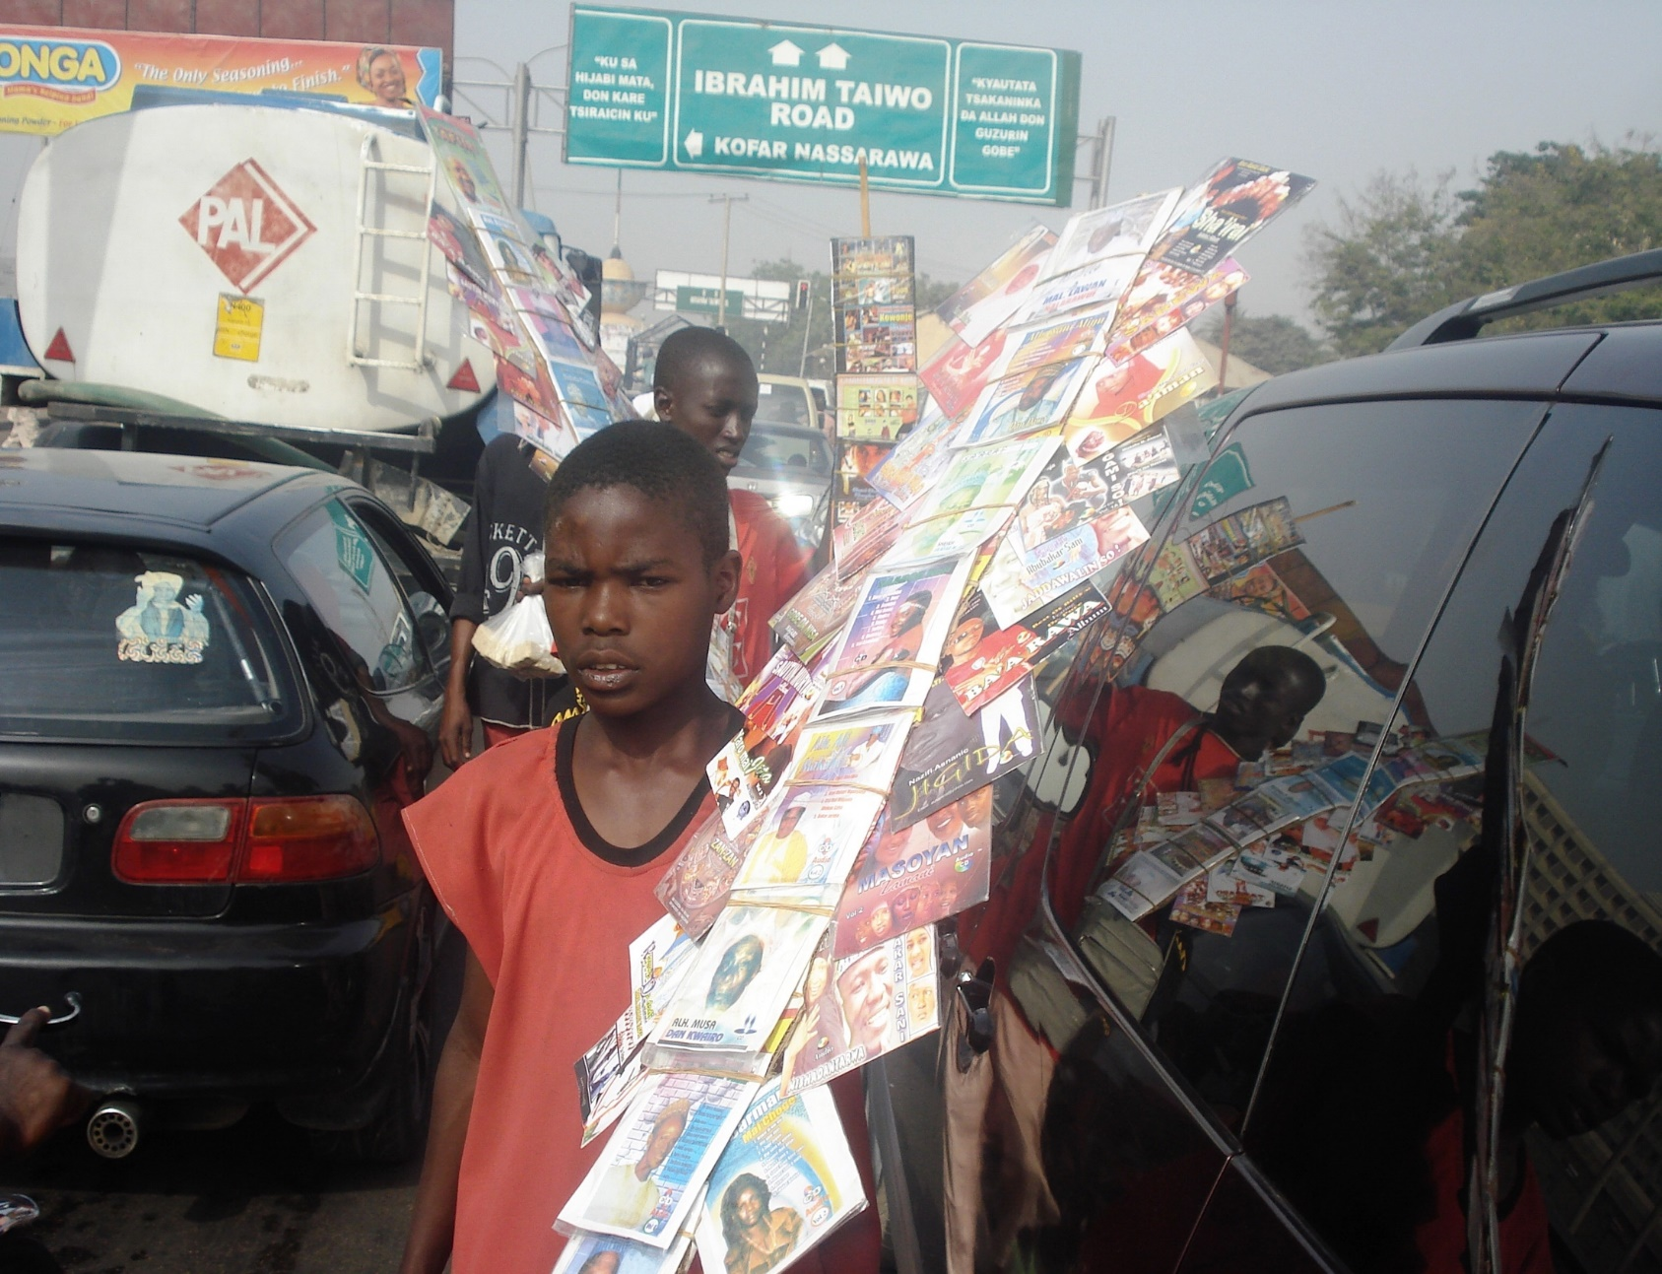
Al-muhajirun pupils selling CDs

Slide 46
Hans Vischer, March1910
Director of Education, AGAINST using ajami because:
By encouraging the study of the Arabic Alphabet the government would be actually assisting in the propagation of the Mohammadan religion
Thus links between ajami and Islam were established right early enough in Nigerian education.
Ajami was therefore discouraged from both educational and public discourse

Slide 47
Christianity and Ajami
Christian Missionaries embraced the use of ajami for evangelical purposes
Translated The Holy Bible since 1932 in Ajami
Islamic scholars DID not embrace the ajami as their Christian counterparts
Thus Christians –appreciating the scriptural power of ajami, continued to use it; often with tragic consequences
German Evangelist Reinhard Bonke Riots in Kano, 1991, facilitated by use of ajami on the posters for the Healing Crusade

Slide 48
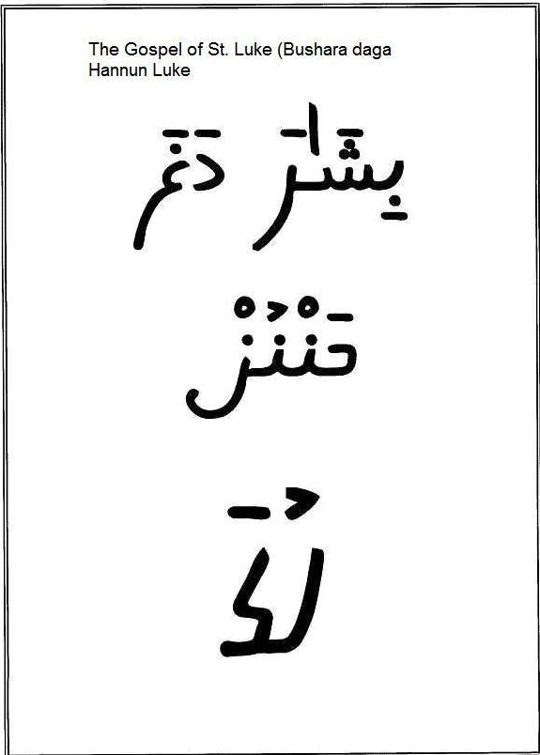
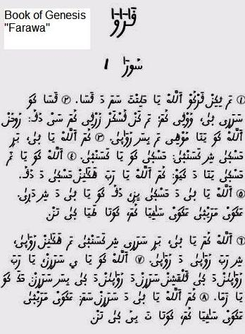

Slide 49
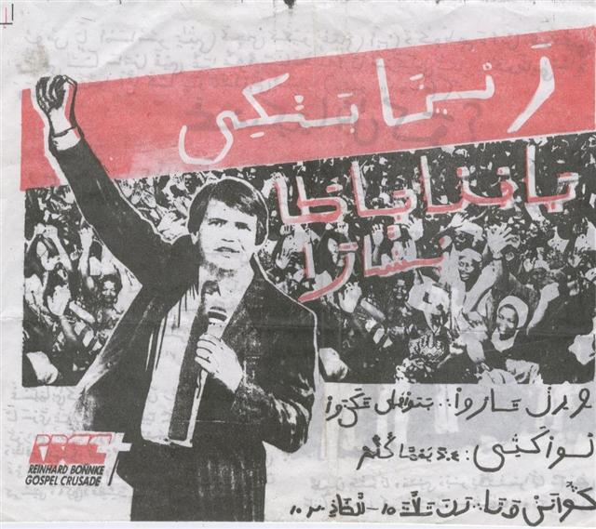

Slide 50
The first official advocacy for Ajami as a literary script was by the British colonial administration in its West African territories
Realizing that their territories is home to millions of scripturally literate Muslims, the British introduced Ajami on their West African currencies – by transliterating the English denomination of the currency with Ajami
This practice was sustained in Nigeria even after independence in 1960 because subsequent Nigerian Governments realize that Ajami is the only form of literacy a huge number of Muslims, especially those from Northern Nigeria can read

Slide 52
It makes it therefore easier for Ajami-literate to engage in the modern Nigerian economy, since they can’t read the Latin script names of the currencies
Consequently, subsequent Nigerian currencies had the Ajami script up to 2007 when a wave of Islamophobia swept Nigeria
The Central Bank of Nigeria suddenly decided that including ‘Arabic inscription’ on the Nigerian currency is mortgaging Nigeria’s sovereignty, as stated by the then Governor of the CBN, Prof. Charles Soludo in February 2007:
It is pertinent to let you understand that Arabic is not one of our national languages and it was inscribed on the notes forty years ago because the majority of people then, can read it in the northern part of the country to the detriment of their counterparts in the South” (to the Sultan of Sokoto)

Slide 53
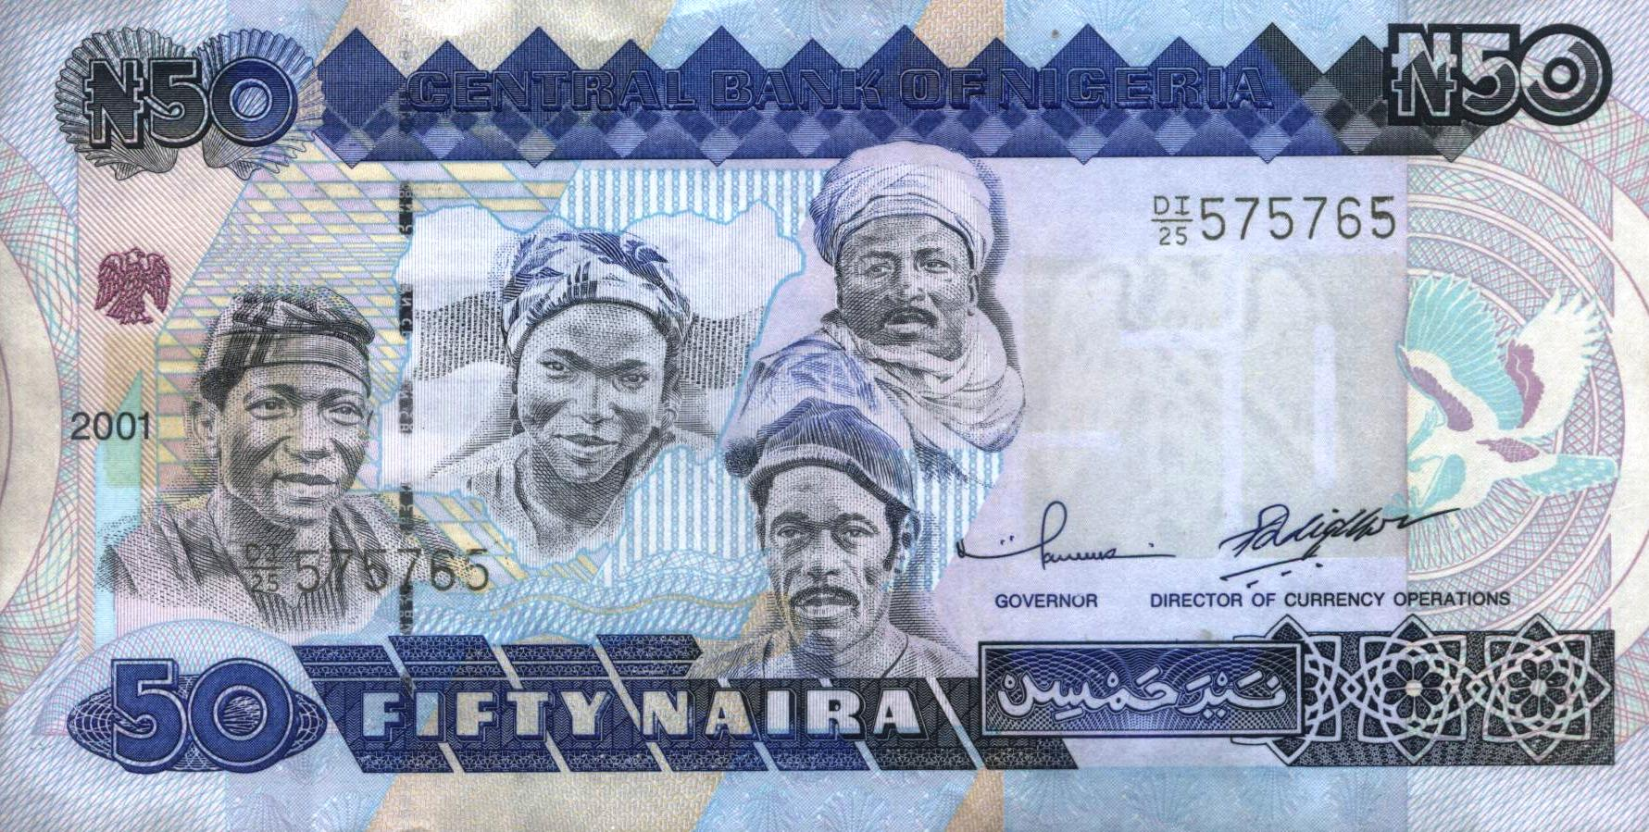
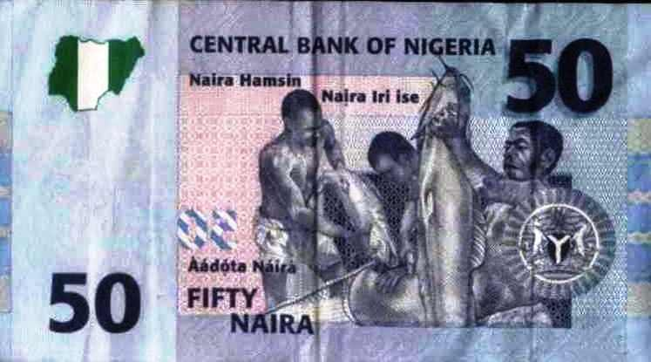
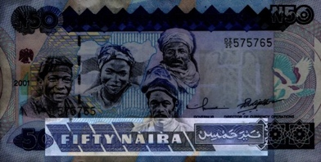
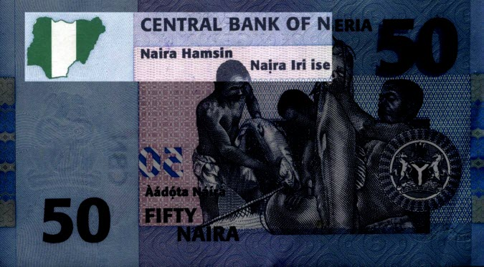

Slide 54
While Ajami was removed, it was replaced by Hausa in Roman alphabet
Yet it was ignored that many Muslim northern Nigerians who have never been to formal schools cannot read the Romanized Hausa, but could easily understand the Ajami script
Interestingly, even the Romanized Hausa is based on Arabic – Hamsin is Arabic for ’50’ – also a Hausa word because more than 40% of Hausa words are derived from Arabic
Thus Arabic still remains on Nigerian currency, in whatever format

Slide 55
Strategizing the Future of Ajami
The manuscript learnability of the Hausa ajami must be revisited as part of Hausa literary public space
It has to become public because the Islamic scholastic establishment shows no willingness to use this conduit network of literacy in truly educating the millions of literature Hausa Muslims
Education for All has been a regular State policy in Nigerian Hausa Muslim territories since the 14th century
Ajami was its main connecting tissue
To realize its scriptural power, it is necessary to contemplate the concept of Ajamization of Knowledge

Slide 56
Efforts made so far to harness the Ajami script for literary purposes beyond religion is at individual and community level, principally centered around the Kasuwar Kurmi booksellers in Kano city, northern Nigeria
A study of the volume of the books and other materials collected over five years and produced by the book sellers indicate an overwhelming focus on religious tract literature—mainly of the textual amulet variety used as incantations in solving one problem or the other

Slide 58
Still based on individual initiatives, some of the Ajami authors I talked to realized that many of their audiences can in fact read Romanized literature—having attended some form of basic modern schooling
This promoted the production of mixed-script reading material—the first of its kind in the history of Ajami literature in Nigeria
This hybrid strategy of mixing the two scripts together works effectively on two levels.
First it acknowledges an increasing Romanized literacy rate among members of the Hausa civil society as a result of increased educational enrolment campaigns
Secondly, it reinforces the significance of ajami as a literary script to the same target audience—thus providing a transition zone between Romanized to ajami scriptural literacy

Slide 59
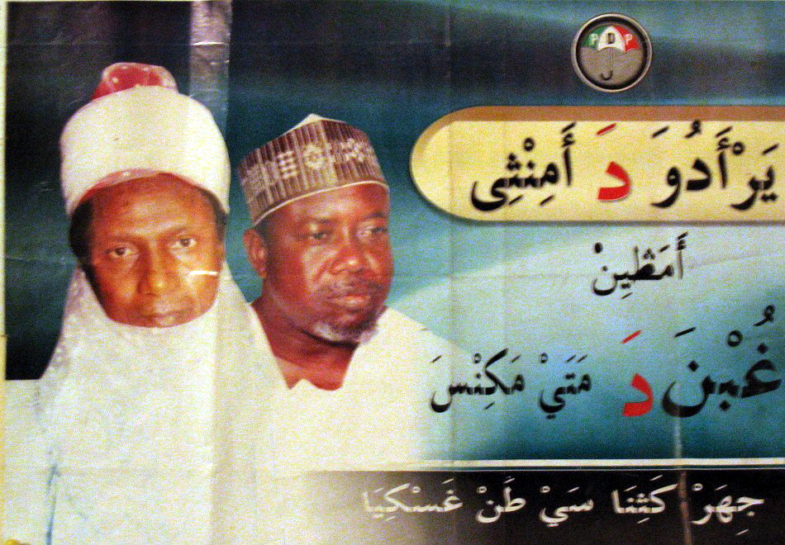

Slide 60
The Ajami campaign poster of late President Umaru Musa ‘Yar Aduwa in his campaign for the position of the Executive Governor of Katsina State in 2003 remained one of the very few attempts by the political class to acknowledge the existence of millions of voters who are literate but excluded with Romanization
Other uses of Ajami in the corporate sphere was by some drug companies who label their drugs with Ajami script to properly educate those not literate in Roman alphabet about what the drug is and what it does
Thus properly harnessed, Ajami can provide effective ways of reaching out to millions of young learners without necessarily being encumbered by having to go through Western education ideals
This will promote peace, stability and understanding among all citizens because literacy is the key to effective community survival

Slide 62
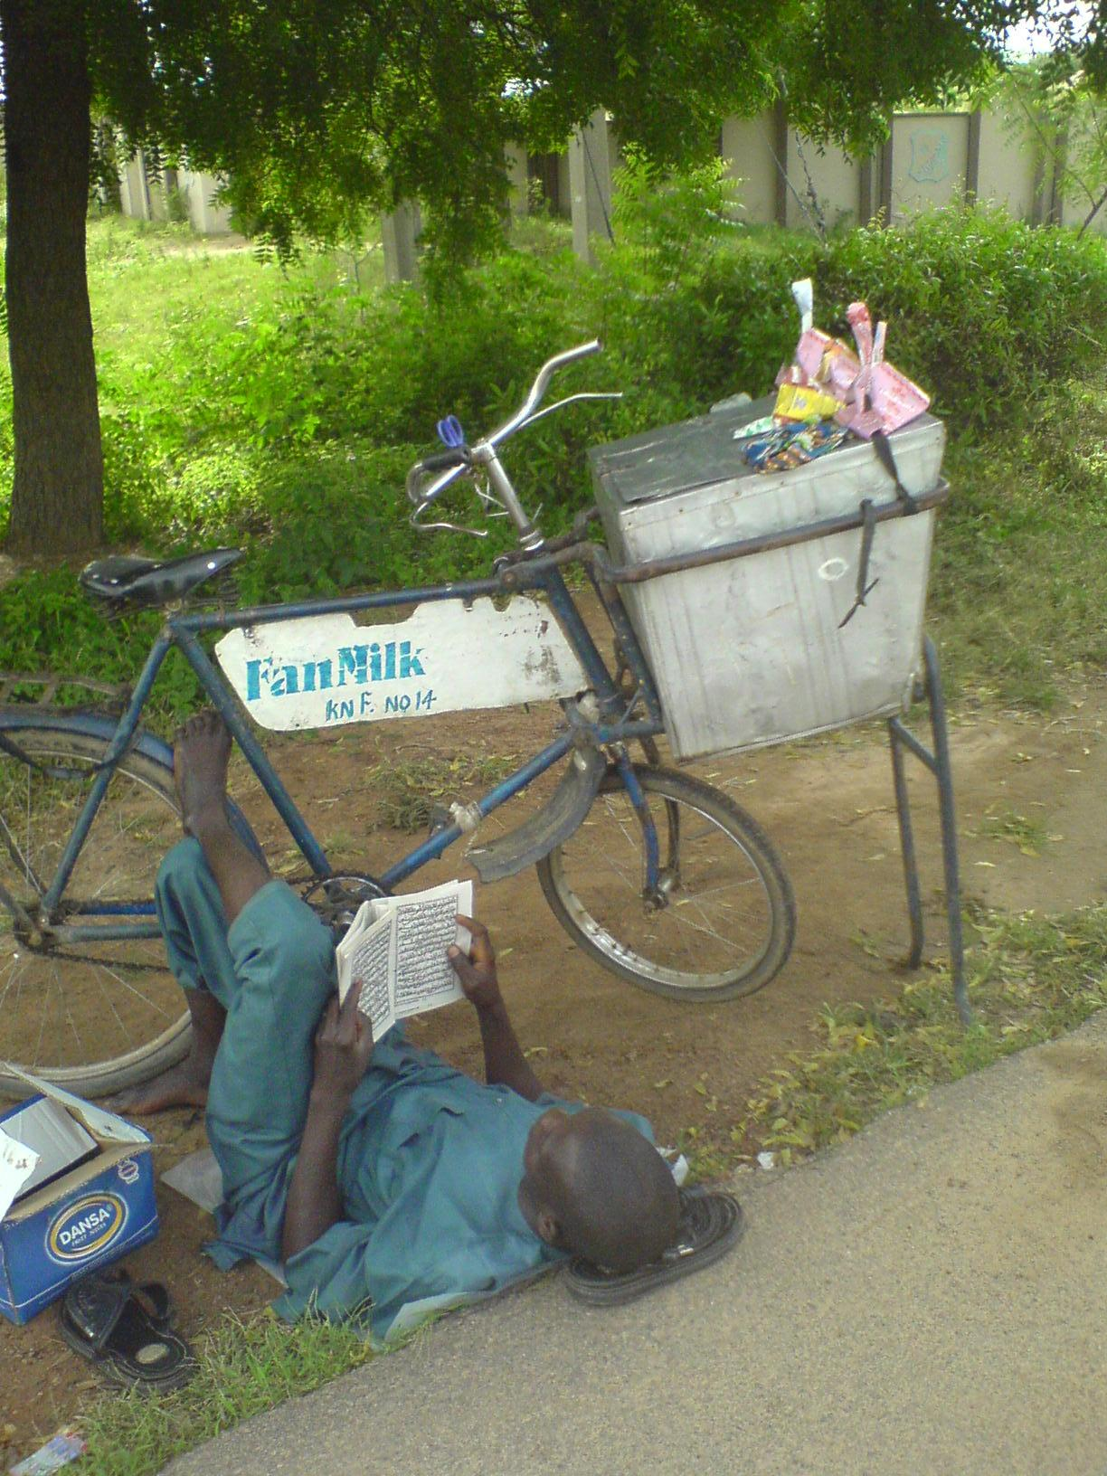
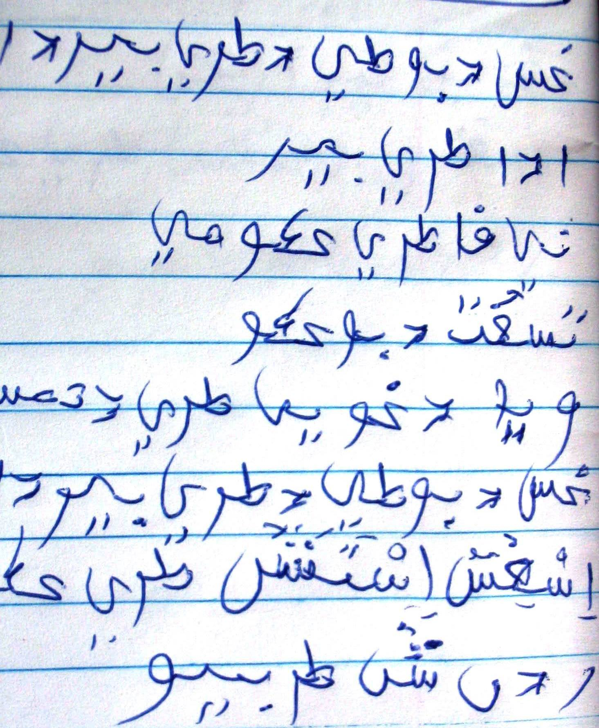

Slide 63
